Slide 1


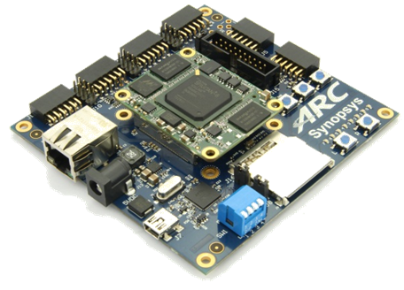
領先創新·
·超越自我
2019 Synopsys ARC盃電子設計競賽

Slide 2

SMART FIREFIGHTER
UETer: DANG Hai Ninh & VU Huong Giang
VNU Key Laboratory for Smart Integrated Systems (SISLAB)
VNU University of Engineering and Technology (VNU-UET)
August 2019
Notes:
Hi, I’m Ninh, from Sislab, VN National University. The project I will present today is smart firefighter, a system which can detect location of the fire and spraying water flow to the fire correctly.

Slide 3

Agenda
Motivation and objectives
Design implementation
Test results
Conclusion
Notes:
My presentation includes...

Slide 4
Agenda
Motivation and objectives
Design implementation
Test results
Conclusion
Notes:
The First, my...

Slide 5
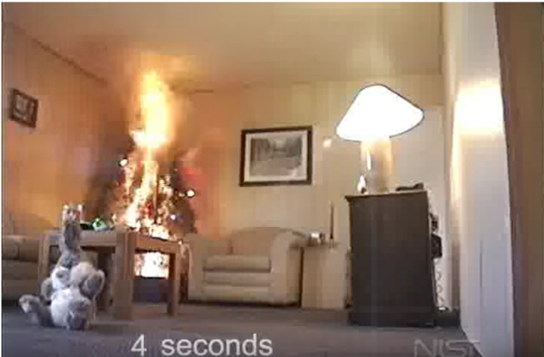
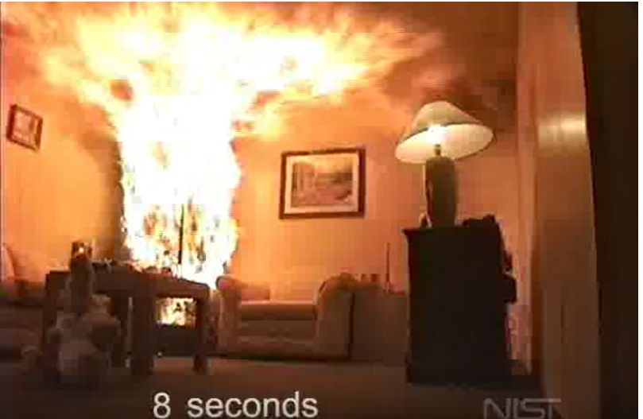
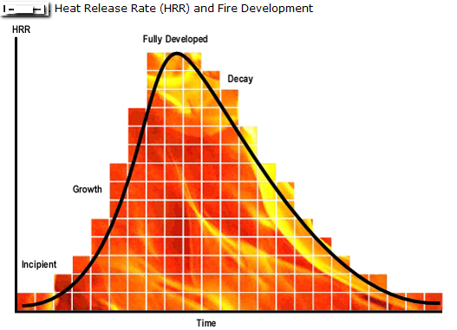
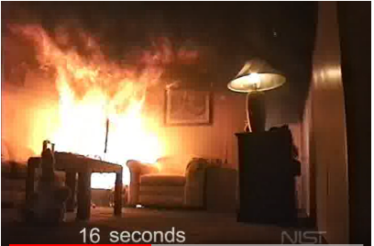
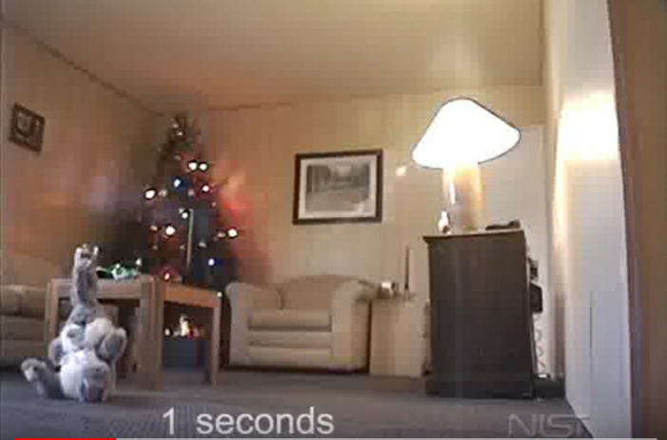
Motivation
8 seconds
4 seconds
16 seconds
1 second
NIST, “Dry Scotch Pine Tree Fire”, source: https://www.youtube.com/watch?v=fsaLCdC3iWw
Quick methods to identify and extinguish fire saving lives and properties
Notes:
Look at the pictures, you can see a Christmas tree bursts into flames in less than 7 seconds, and turned into disaster with only 16 seconds, so...

Slide 6
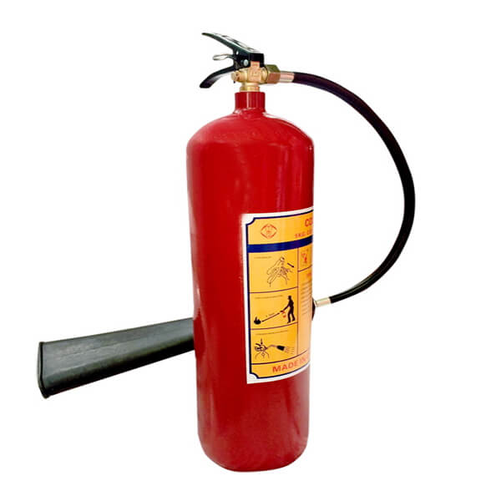
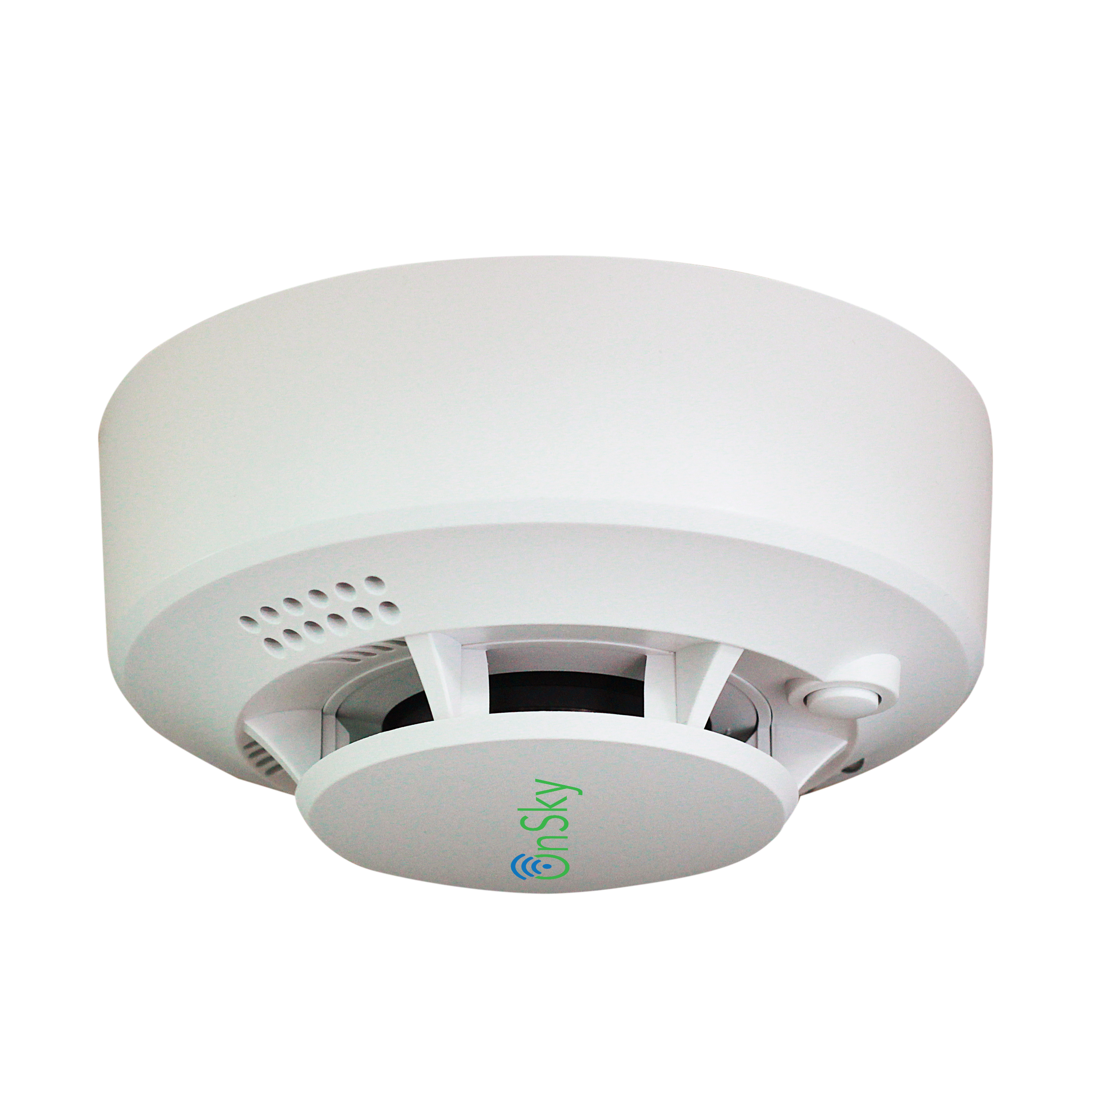
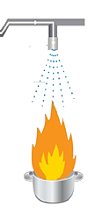
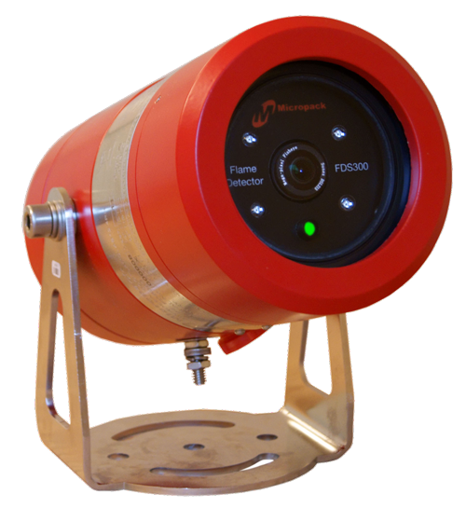
Motivation (cont.)
Traditional methods
Fire extinguisher
Heavy
Limited visibility
Industrial flame sensor
Sensitive and fast fire detection
No location of flame
Expensive
Smoke sensor:
Slow detection
No location of flame
Wide water spray nozzle:
Waste water
Causing damage to other furniture
Notes:
Overview of popular firefighting methods, The most common method is to use a fire extinguisher, but heavy and don’t run when you sleep.

Slide 7
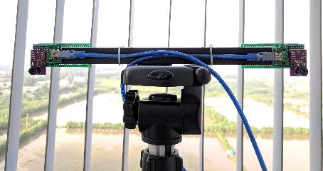
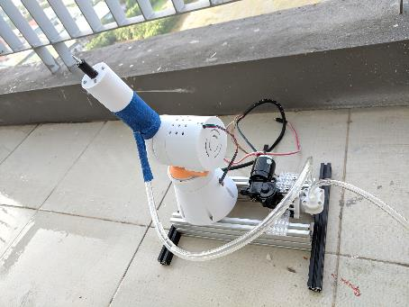
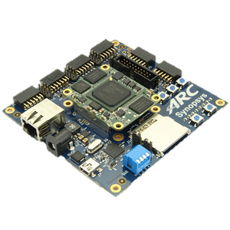
Our objective: low-cost smart fire fighter
Fire detection: Low-cost InfraRed Sensors
Autonomously detect and extinguish the fire
Quick and accurate detection of flame location
3D-printed robot arms
Spraying water flow to the fire correctly, while keeping other areas dry
ARC EM Starter kit-based algorithms & controls
Notes:
So, that is our objective...

Slide 8
Agenda
Motivation and objectives
Design implementation
Test results
Conclusion
Notes:
Now, this is...

Slide 9
Processing flow
Start
IR camera send pixel array to EMSK
NO
EMSK calculates the distance to the heat source and
determines "IS IT A FIRE?”
YES
The two
axis robot arm sprays water to put out the fire

Slide 10
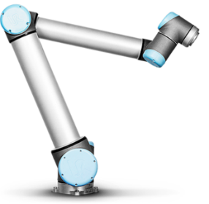
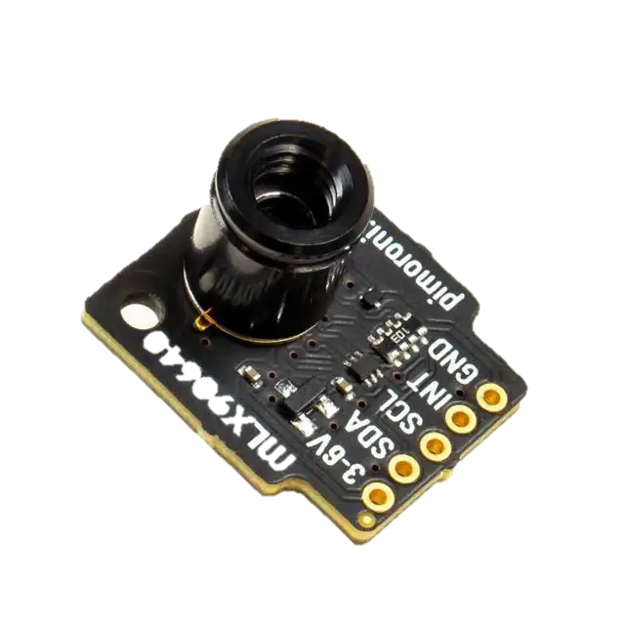

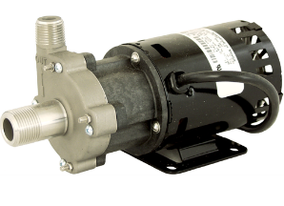
System components
2 stepper motor
UART
Move spray nozzle
Flame directions
2 axis robot arm
UART
H bridge
Flame directions
Spray water
Calculate flame locations
Water pump
2x thermal sensor 32x24 pixel
FOV: 55°x35°
ARC EM Starter Kit
Two low-cost Infrared sensors
3D-printed robot arms controlled by step motors
One water pump

Slide 11
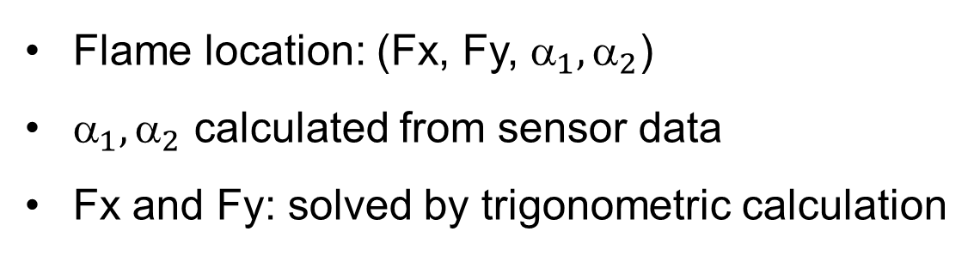
Flame Detection
Angle calculation from sensors
Detection range: 4m x 4.4m x 4.4m
Hottest pixel: xh = 2, yh = 1
- X angle: α = (55/32)*xh
- Y angle: β = (35/24)*yh
- 2 sensor: α₁, α₂, β₁, β₂
Flame location: (Fx, Fy, ${\text{}}_{1},{\text{α}}_{2}$)
${\text{}}_{1},{\text{α}}_{2}$ calculated from sensor data
Fx and Fy: solved by trigonometric calculation

Slide 12
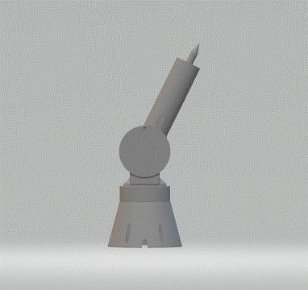
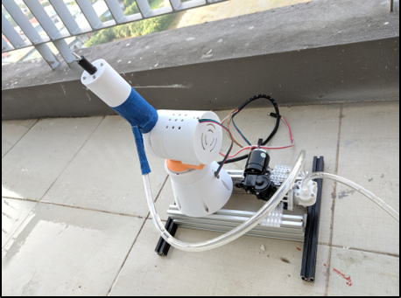
3D-printed robot hand for spraying water
Robot arm 3D model
3D-printed robot arm with two step motors
Extinguish fire by using a robot hand with two joints to spray water to the position of fire

Slide 13
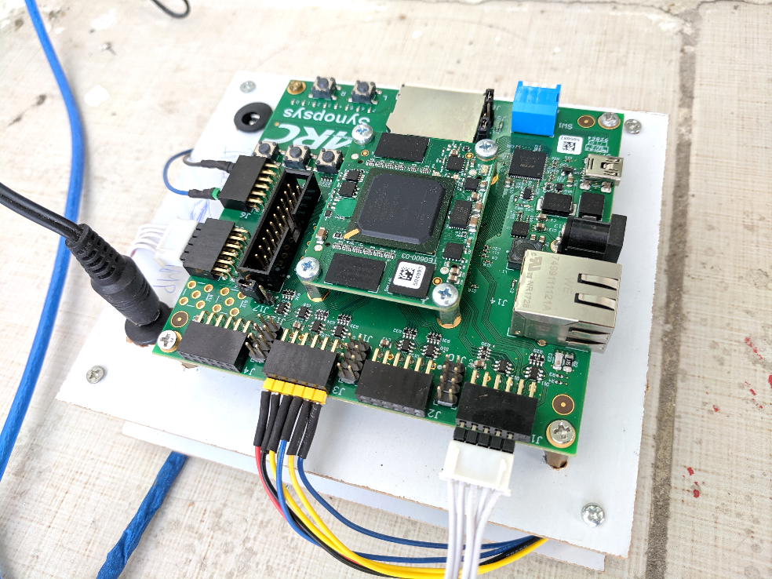
ARC EM Starter Kit connections
J6 : Relay module for water pump control
J3 : 2 Stepper driver module.
J1 & J5 : 2 IR camera module (using UART).

Slide 14
Agenda
Motivation and objectives
Design implementation
Test results
Conclusion

Slide 15
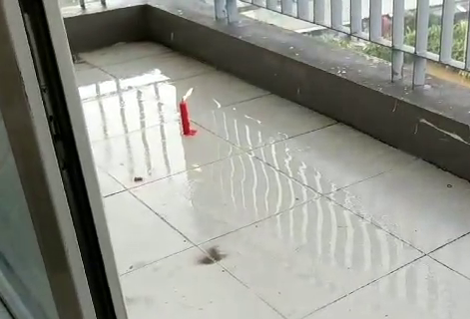
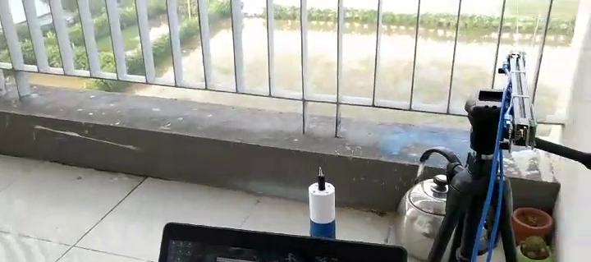
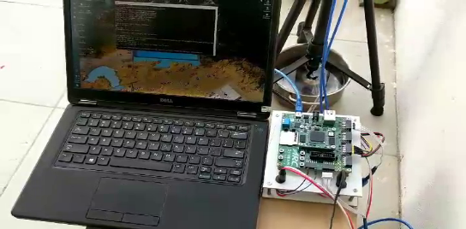
Demonstration setup
IR Sensors
Robot arm
ARC EM Starter kit
Fire: a candle

Slide 16
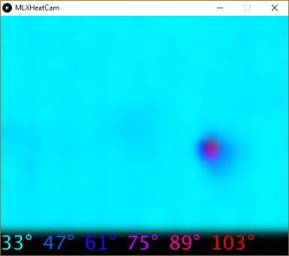
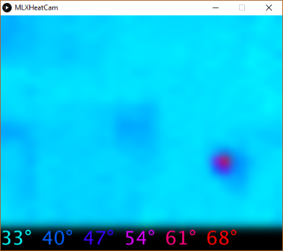
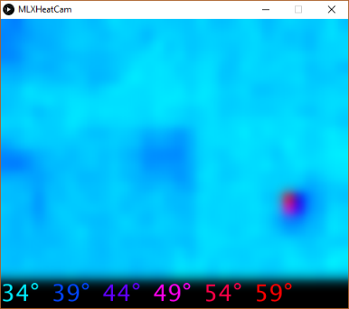
Candle flame visualization using a single sensor
Distance: 1m
Distance: 2m
Distance: 3m
Notes:
At 1 meter, The candle shows 103c,...

Slide 17
Agenda
Motivation and objectives
Design implementation
Test results
Conclusion

Slide 18
Conclusions
Fire grows very fast in home environment & Industrial smart firefighters are very expensive
Our proposal: Low-cost Smart Fire Fighter
Low-cost IR sensor for fire detection
3D-Printed Robot arm for water control for extinguishing fire
Using ARC EM Starter Kit for algorithm development & control
Future works
Multi-sensor nodes with wireless connections
Embedded machine learning for fire classification
Notes:
In future, We have plans setup Multi-sensor nodes with wireless connections to Extend protection area.

